Slide 1
Causes of the French Revolution
Ashley Siavoshi

Slide 2
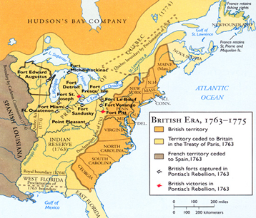
The Seven Years War (French and Indian War)
France lost much of their landholdings in the Americas
Caused a huge financial drain
Fighting overseas wars costed more than one in France itself
Light yellow = lands that France ceded to America as a
result of the Treaty of Paris

Slide 3
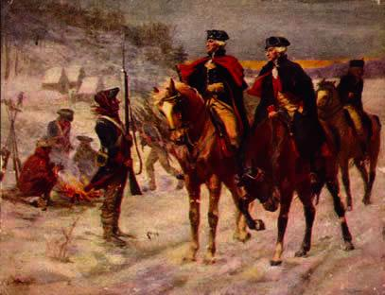
The American Revolution's Effects
Inspired French revolutionaries to act
The French government practically paid for the American Revolution
Caused a major economic deficit
French expected the Americans to help them in their war because
they had helped them
Washington remained neutral
French Marquis Lafayette visiting George Washington at
Valley Forge during the American Revolution.

Slide 4
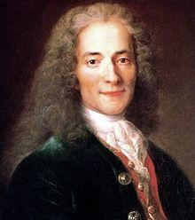
The Enlightenment's Effects
Brought about many new ideas
Liberty
Equality
Reason
Inspired people to claim their "natural rights"
Philosophes
Locke - defended private property, limited sovereignty
Voltaire - attacked noble's privileges and Church authority

Slide 5
Intellectual Causes
Liberalism
philosoph's ideas had spread throughout Europe
Age of Enlightenment / Reason
Sovereignty of people
Higher literacy rate in lower classes
wide spread of radical works
common people had ideas about politics

Slide 6
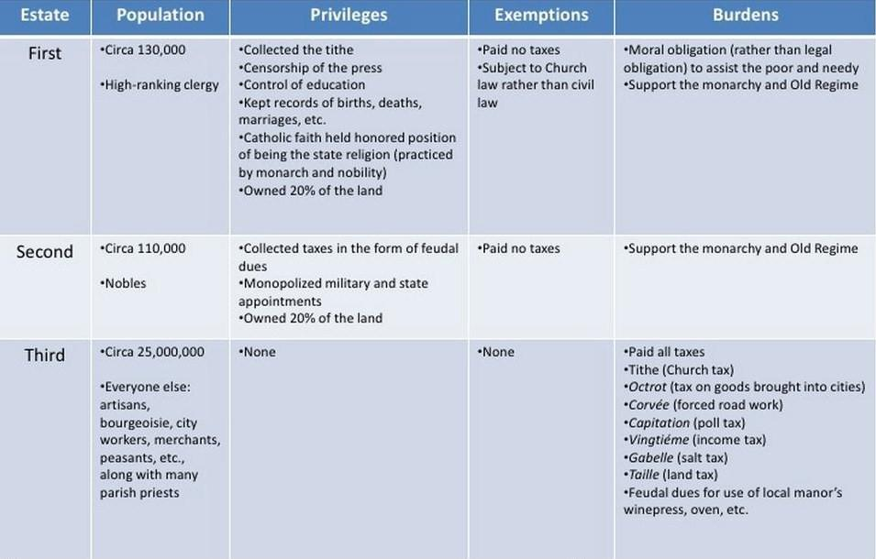
Social Causes
Estate system

Slide 7
Social Causes (continued)
Estate system unfair because most of the population was in the Third Estate, yet they only got one vote as a whole
First and Second Estates often sided with the King, outnumbering the Third Estate
Subdivisions of the Third Estate
Bourgeoisie, peasants, urban poor
Feudalism and seigneurialism still present
Increasing population
Needed more supplies (supply and demand)
This, as well as poor harvests, lead to increased price in bread

Slide 8
Economic Causes
Commerce struggling
Bank no longer lent money to king (he would spend it all on self or on wars)
King reverted to taxation of lower classes
Taxation problems
those unable to pay were taxed
Upper classes were exempt
Third Estate had to pay most of the taxes, yet they were not represented in government
"Taxation without representation" (idea brought up in American Revolution)

Slide 9
Economic Causes (continued)
Dependence on loans from other countries
interest rates began to rise
most of yearly income of government went to paying off loans, mainly because of the interest
Nobles in Versailles lived an extravagant lifestyle
Marie Antoinette called "Lady Deficit"
Poor harvests raised the cost of grain and, therefore, bread, a staple of common people in France

Slide 10
Finance Ministry's Attempts
Turgot
tried economic reforms like restrictions on commerce and cutting expenses
Disliked by the nobles
Louis XIV removed him and hired Necker
Necker
Avoided new taxes
Took out large loans from other countries
Replaced by Calonne
Calonne
Stated that the monarchy was on the verge of bankrupcy
Tried to instigate new taxes

Slide 11
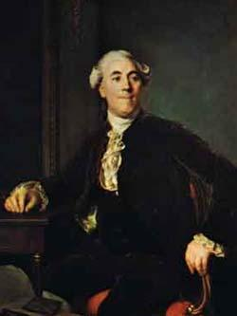
Finance Ministry's Attempts (continued)
Assembly of Notables did not support him
Replaced by Archbishop Brienne
Archbishop Brienne
Member of the Assembly of Notables
Did not do much, simply restated Calonne's ideas
After the Parlements urged a meeting of the Estates General, Louis XIV
recalled Necker and agreed to
hold a meeting of the Estates
General
Portrait of Necker

Slide 12
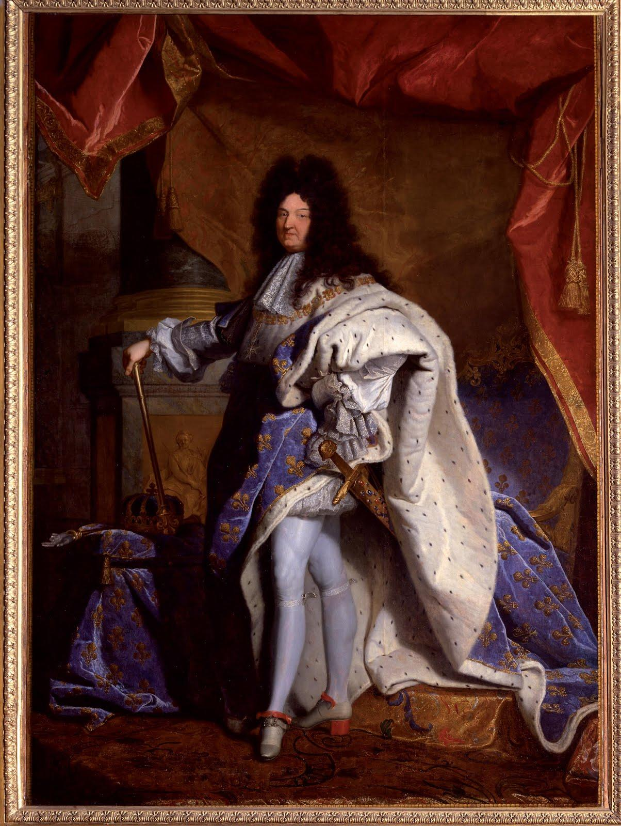
The King
Louis XIV not intelligent/ skilled enough to effectively rule
Spent extravagantly at Versailles
Waged very expensive wars to ensure he kept his territory
Ran France into debt

Slide 13
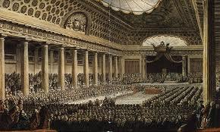
The Calling of the Estates General
Eventually called in 1798
The rich resisted attempts at taxation, demanded the Estates General be called
Had not been called in over 150 years
Third Estate not given equal vote
"What is the Third Estate?" by Sieyes
Debates rose over organization and fairness of voting
Parlement of Paris
ruled that each estate
gets one vote (1788)

Slide 14
The National Assembly
The Third Estate refused to obey the king and accept its single vote
Gathered away from the main meeting room
Declared themselves National Assembly on June 17, 1789
Real representatives of the French people
Supported by lower clergy and nobility
Later renamed itself the National Constituent Assembly

Slide 15
The Tennis Court Oath
June 20, 1789
Third Estate locked out of main meeting hall of Estates General, so they met at a tennis court
Declared not to leave until they had a constitution for France
Many of the clergy and nobility seemed interested in joining the National Assembly
June 27 -> Louis XIV send the remainder of the clergy and nobility to join the Assembly, acting as if it had been his idea

Slide 16
Reactions to the Assembly
Louis XIV refused to cooperate with the Assembly
The assembly was working towards a constitutional monarchy which would remove Louis XIV of his absolutist power
July 11 -> Louis XIV dismissed Necker without informing the Assembly
Citizens of Paris believed that Louis intended to go on offensive against Paris
They created a citizen militia to protect themselves

Slide 17
The Storming of the Bastille
On July 14, around 800 citizens went to the Bastille, a fortress in Paris, to demand weapons for the citizen militia
Denied the weapons, the crowd stormed the Bastille and killed the governor
Unfortunately, they found no weapons inside
The militia of Paris became the National Guard
The Revolution was now underway

Slide 18
Works Cited
Causes of the French Revolution. YouTube. SDPickensCounty, 17 Nov. 2010. Web. 18 Dec. 2012.
"Causes of the French Revolution." Interesting Facts Information Tourism Travel Culture Language Business People
RSS. N.p., 29 Mar. 2010. Web. 18 Dec. 2012.
Chambers, Mortimer. The Western Experience. 9th ed. Boston: McGraw-Hill, 2007. Print.
"France History - Causes of the French Revolution." Causes of the French Revolution. Bonjour La France, n.d. Web.
18 Dec. 2012.
The French Revolution: Causes of the Revolution. YouTube. HowStuffWorks, 31 Oct. 2009. Web. 18 Dec. 2012.
Kagan, Donald, Steven E. Ozment, and Frank M. Turner. The Western Heritage. Upper Saddle River, NJ: Prentice
Hall, 1998. Print.
Schwartz. "Causes of the French Revolution." Causes of the French Revolution. N.p., n.d. Web. 18 Dec. 2012.

Slide 19
Picture Links (in order of appearance)
http://www1.american.edu/ted/ice/images4/kckbritish-era-1763-75.png
http://www.schillerinstitute.org/graphics/Art_Work/cooper_patriot/Lafayette_Washington_Valley-Forge.jpg
http://upload.wikimedia.org/wikipedia/commons/thumb/f/f2/Atelier_de_Nicolas_de_Largilli%C3%A8re,_portrait_de_
Voltaire,_d%C3%A9tail_(mus%C3%A9e_Carnavalet)_-002.jpg/220px-Atelier_de_Nicolas_de_Largilli%
C3%A8re,_portrait_de_Voltaire,_d%C3%A9tail_(mus%C3%A9e_Carnavalet)_-002.jpg
http://bastille-day.com/media/Necker-1.jpg
http://dummidumbwit.files.wordpress.com/2009/03/louisxiv.jpg?w=640
http://upload.wikimedia.org/wikipedia/commons/thumb/9/91/Estatesgeneral.jpg/300px-Estatesgeneral.jpg

